Slide 1
Apex
A Car Rental System for EveryOne
Presented By
P.Kasi
22B91A61C7

Slide 2
ABSTRACT
The Car Rental System project is a web-based platform that allows vehicle owners to rent out their cars to others for a specified time at affordable rates. The system enables users to list their vehicles, specify rental duration, and set charges. Renters can browse available cars, check prices, and make bookings directly through the platform. HTML, CSS, and JavaScript are used to design an interactive and user-friendly interface, ensuring easy navigation for both vehicle owners and renters. The project aims to provide an affordable and flexible alternative to traditional car rental services. It also allows for seamless communication between vehicle owners and renters, ensuring trust and transparency. This solution promotes resource-sharing and can benefit individuals who need a vehicle temporarily while allowing car owners to earn extra income.

Slide 3
Introduction
The Car Rental System is an innovative platform that connects vehicle owners with individuals in need of temporary transportation. It provides a cost-effective solution by allowing users to rent cars at lower prices compared to traditional rental services. The system works by enabling car owners to list their vehicles for rent, while renters can browse and book available cars for specific durations. This platform simplifies the process of vehicle rental, offering convenience and flexibility to both parties. It promotes sharing economy practices, helping car owners generate income from their idle vehicles. Additionally, it offers a wide range of vehicle options for renters, meeting diverse transportation needs. This system enhances accessibility to affordable transportation while supporting the community.

Slide 4
Problem Statement
The problem arises from the limited accessibility and high costs of traditional car rental services. Many individuals own cars that remain unused for extended periods, leading to underutilization of resources. This project aims to provide an affordable, flexible platform that allows vehicle owners to rent out their cars to others, maximizing the utility of idle vehicles.

Slide 5
Solution
The solution to this problem is the development of a Car Rental System website, where vehicle owners can easily list their cars for rent at affordable rates. Renters can browse available vehicles, check prices, and book them for specific durations, all through a user-friendly platform. This system promotes resource optimization, reduces transportation costs, and provides a convenient way for both car owners and renters to meet their needs.

Slide 6
Key Goals And Benifits of the Project
Affordable Transportation: Provides an economical alternative to traditional car rental services, helping users access vehicles at lower rates.
Resource Optimization: Allows car owners to monetize their idle vehicles, making better use of available resources.
Convenience and Flexibility: Offers a simple, user-friendly platform for both vehicle owners and renters to manage listings, bookings, and payments.
Sustainability: Supports the sharing economy, encouraging the reuse of cars and reducing the demand for additional vehicle production.

Slide 7
Technology Used
1.HTML
2.CSS
3.JAVASCRIPT

Slide 8
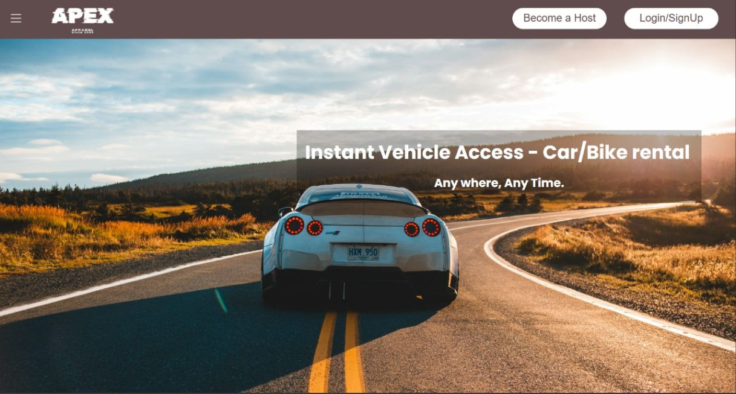

Slide 9
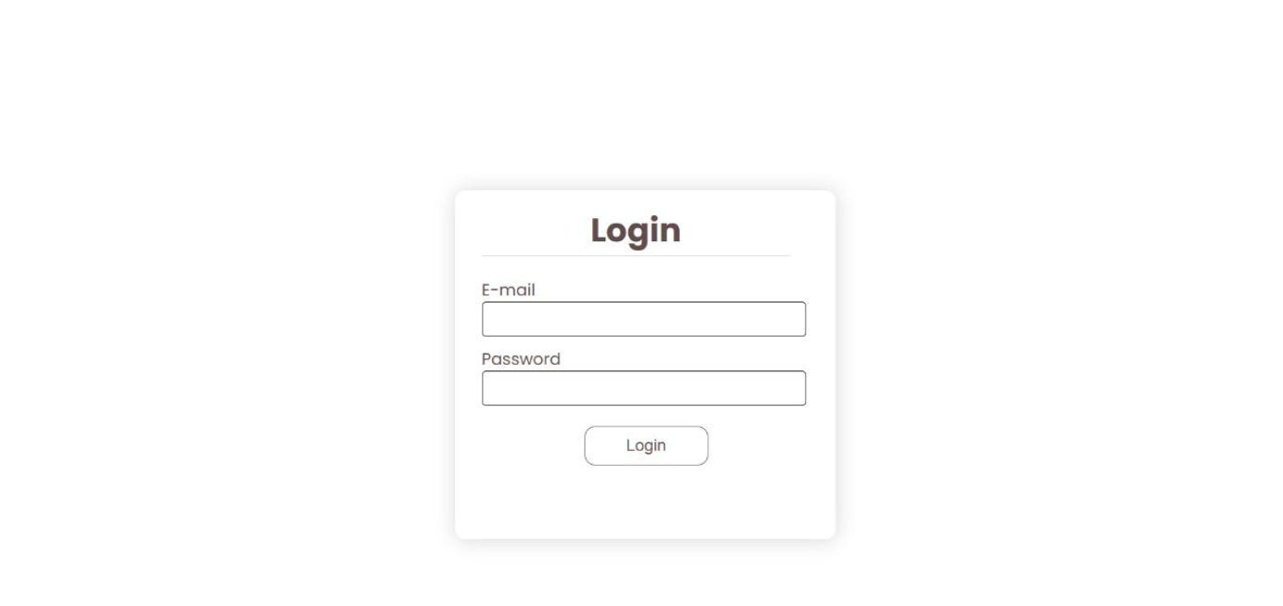

Slide 10
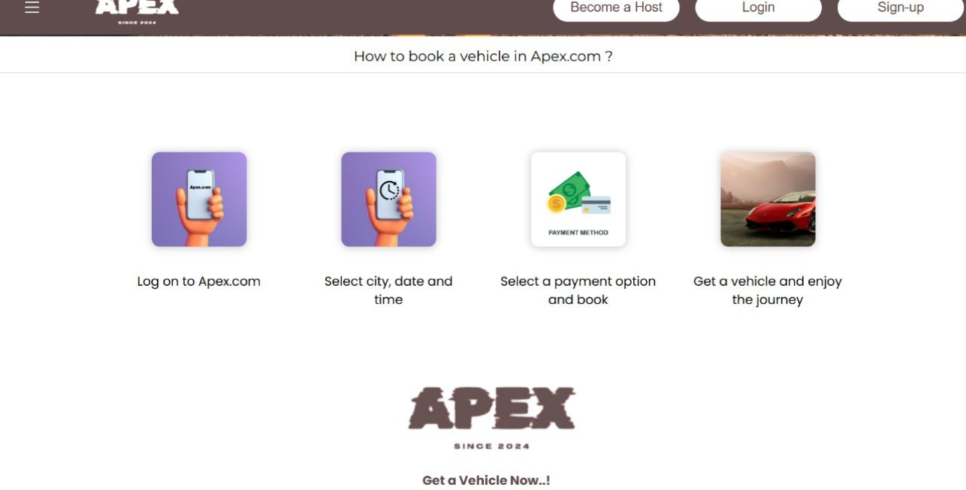

Slide 11
Thank You

